Slide 1
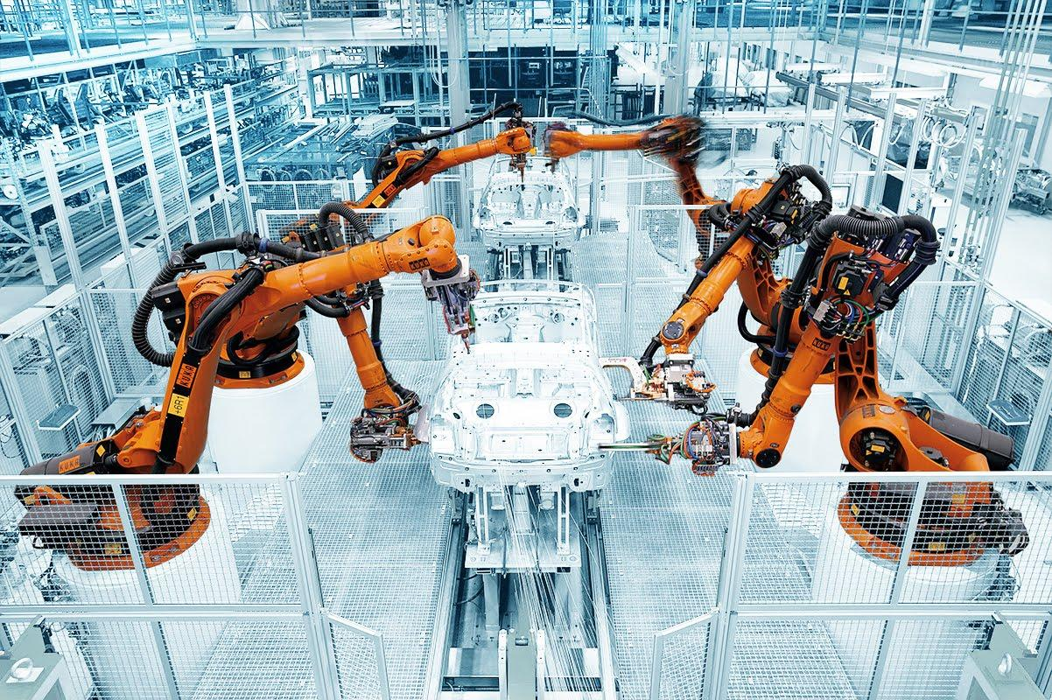
Case Assessment| Industrial Robotics
1
© TechSci Research

Slide 2
Industrial Robotics
Table of Contents
Introduction
Patent Analysis
Industrial Robotics Market Overview
Industrial Robot Installation 2012-2030
Key Trends & Developments
Products/Technologies Launches
03
04
08
10
13
14
1
2
3
4
5
6
2

Slide 3
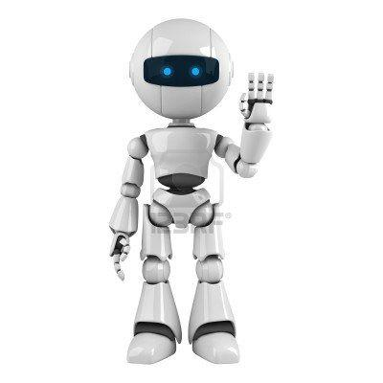
Industrial Robotics
Introduction | Robotics
Robotics is an interdisciplinary field encompassing science, engineering, and technology that involves designing, building, operating, and applying robots. These autonomous machines can undertake tasks, often in collaboration with humans, across diverse sectors such as industry, research, healthcare, and space exploration.
Innovation within robotics holds significant significance in driving various domains. It not only elevates a nation's manufacturing capabilities and military strength but also augments overall industrial efficiency, enabling workers to engage in more complex tasks that require human ingenuity.
Patent activity serves as a key indicator of a country's prowess in robotics technology. Robust patenting reflects active research, development endeavors, and substantial national investments, showcasing a nation's commitment to advancing in the field of robotics.
Industrial Robot
Service robot
Caged Industrial
Robot
Co-Bot
Medical Robot
Logistics Robot
Consumer robot
Autonomous
vehicle
Drone
Surgical Robot
Exoskeleton
Care Robot
Hospital Robot
Smart Home
Robot
Personal Robot
Military Drone
Commercial
Drone

Slide 4
Industrial Robotics
Patent Analysis | Robotic Patents (2013-2022)
Robotic Patents^{(a)} Filed and Granted (2013-2022)
Key takeaways
From 2013 to 2021, 72,618 robotics patents were granted globally. Leading nations include China (35%), Japan (21%), South Korea (15%), and the United States (13%).
Continuous advancements in robotics technologies such as artificial intelligence, machine learning, computer vision and sensor technologies have lead to the development of more sophisticated and capable robots.
In the last ten years, the year 2018 witnessed highest number of granted patents for robotics as well as the highest number of patent applications filed.
On average there were about 14,309 robotics patents granted each year during this period while the yearly average for filed patent applications was around 21,731.
On comparing the average annual count of robotics patents granted in the recent five year span (2018 to 2022) and comparing it with the preceding five years (2013 to 2017), there was a remarkable increase of 193.27% in grants. Similarly, filings also saw substantial growth of 187.62% during the same periods.
Note(s): (a) Robotic patents till 2019 is sourced from public domain, from 2019 onwards data is forecasted considering market trends, historic curve and expected growth rate,
Sources: Center for Security and Emerging Technology, World Robotics 2022

Slide 5
Industrial Robotics
Patent Analysis | Robotic Patents Filed & Granted By Top Countries (2013-2021)
Robotic Patents by Top Countries (2013-2021)
Industrial Robotic Patents by Top Countries (2013-2021)
Share of Industrial Robotics Patents out of the Total Robotics Patents (2013-2021)
Globally, robotics patents are booming, surpassing patents in all sectors. Leading countries in robotics patents from 2013 to 2022 were China, the United States, Japan, South Korea, and Germany. These patents mainly cover machine components, control systems, and industrial robotics.
In 2011, China became the global leader in patent applications. By 2019, China solidified its position as the world leader in granted patents, demonstrating its growing success in securing approved patents compared to other nations.
China became the top global market for industrial robots in 2013, surpassing Japan. By 2019, Chinese suppliers contributed 29% of global robotics units, up from 26% in 2018 and 25% in 2017.
The demand for automation in industries is driven by the goals of boosting efficiency, cutting costs, and enhancing production quality. As industries pursue automation, the potential for patentable innovations in robot design, control systems, and integration with other technologies is on the rise.
Note(s): (a) Robotic patents till 2019 is sourced from public domain, from 2019 onwards data is forecasted considering market trends, historic curve and expected growth rate,
Sources: Center for Security and Emerging Technology

Slide 6
Industrial Robotics
Patent Analysis | Worldwide Granted Robotic Patent By Category
S.No. | Category | No. of Patents | Leading Country
1 | Physical Components | 24,307 | Japan
2 | Industrial | 23,360 | China
3 | Control Systems | 20,204 | Japan
4 | Sensors/Measurement | 12,756 | China
5 | Medical | 8,146 | United States
6 | Transportation | 6,752 | China
7 | Vision | 5,107 | Japan
8 | Consumer | 3,168 | South Korea
9 | Humanoid/Exoskeleton | 2,166 | China
10 | Entertainment | 1,894 | Japan
11 | Agriculture | 1,556 | China
12 | Underwater | 1,178 | China
13 | Artificial Intelligence | 1,116 | United States
14 | Aerospace | 890 | United States
Key Takeaways
Robotics patents are categorized into 14 types, covering areas like aerospace, agriculture, consumer, entertainment, and more.
These patents encompass various features, including artificial intelligence, physical components, control systems, sensors, measurement, speech, and vision.
It's common for a single patent to belong to multiple categories and feature groups, creating overlaps.
The United States leads in aerospace, medical, military/security, telepresence, and AI robotics patents.
Japan excels in patents related to physical components, as well as those categorized under entertainment, control systems, speech, and vision.
China stands out in industrial applications, sensors/measurement, transportation, humanoid/exoskeleton, agriculture, underwater, and education robotics patents.
South Korea takes the lead in consumer robotics patents.
These trends have emerged from comparing the highest number of granted robotics patents in various categories from 2013 to 2022.
Note(s): (a) Robotic patents till 2019 is sourced from public domain, from 2019 onwards data is forecasted considering market trends, historic curve and expected growth rate,
Sources: Center for Security and Emerging Technology

Slide 7
Industrial Robotics
Patent Analysis | Top 15 Global Robotics Patent Grantees
Ranking | Organization | Origin
1 | Samsung Electronics Co Ltd | South Korea
2 | Yaskawa Electric Corp | Japan
3 | Fanuc Corp | Japan
4 | Lg Electronic Co Ltd | South Korea
5 | Seiko Epson Corp | Japan
6 | Harbin Inst Technology | China
7 | Panasonic Corp | Japan
8 | State Grid Corp of China | China
9 | Univ Shanghai Jiao Tong | China
10 | Samsung Heavy Industries Co Ltd | South Korea
11 | Hitachi Ltd | Japan
12 | Midea Group | Germany
13 | Univ Tsinghua | China
14 | Olympus Corp | Japan
15 | Univ Zhejiang | China
Key Insights
Diverse Patent Portfolios: Among the Top 20 Global Robotics Patent Grantees, there is a diverse range of companies and countries represented, showcasing the global nature of industrial robotics innovation.
Strong Asian Presence: Asian countries, particularly China and Japan, have a significant presence in industrial robotics patents, reflecting their leadership in this sector.
China's Rapid Growth: China has experienced remarkable growth in industrial robotics patents over the past decade, demonstrating its commitment to automation and manufacturing.
Established Players: Traditional robotics and manufacturing powerhouses like Japan and Germany continue to be strong patent contributors, emphasizing their ongoing commitment to technological advancements in industrial robotics.
Diverse Applications: Industrial robotics patents cover a wide range of applications, from manufacturing and automation to logistics and material handling, highlighting the versatility and importance of robotics in various industries.
Note(s): (a) Robotic patents till 2019 is sourced from public domain, from 2019 onwards data is forecasted considering market trends, historic curve and expected growth rate,
Sources: Center for Security and Emerging Technology

Slide 8
Industrial Robotics
Industrial Robotics| Market Overview
Overview
Manufacturing robots are complex, with factors like supply chains and purpose-driven sophistication affecting their complexity.
Modern robotics leverages on-board and cloud-based processing for enhanced capabilities and insights among robots.
Robotics involves coordinating hardware and software components to interpret data and make decisions.
AI-equipped industrial robots enable automation of complex tasks, collaborate safely with humans, and improve productivity and safety in diverse industries.
Industrial Robot
Caged Industrial
Robot
Surgical Robots
Co-Bots
Exoskeletons
Logistic Robot
Care Robots
Robot Manufacturers
Medical Robot
Hospital Robots
Consumer Robot
Smart Home Robots
Service Robot
Autonomous Vehicles
Social Robots
Military Drones
Machine Learning
Robot Brains
Commercial Drones
Machine Vision
Robotic Intelligence
Software's
Gesture Control
Cloud Robotics
Conversational
Robot Components
Mechanical Components
Sensor
Hardware
AI Chips
Semiconductors
Communication

Slide 9
Industrial Robotics
Industrial Robotics| Industrial Robotic System
Articulated Robots
SCARA Robots
Grippers
Clamps
Up to 20 kg
20kg – 60 kg
Parallel/ Delta Robots
Linear Robots
Suction Clamps
Tool Changers
Payload Capacity
60.01kg – 200 kg
End Effectors
Cartesian Robots
Gantry Robots
Welding Guns
Detouring Tools
More than 200 kg
Industrial Robot Types
Accessories for Industrial Robots
Industrial Robot Payload Capacity
Industrial Robotic System
Cylindrical Robots
Spherical Robots
Mining Tools
Soldering Tools
Pressure Sensors
Proximity Sensors
Swing-arm Robots
Water Handlers
Controllers
Vision System Components
Force Sensors
Position Feedback Sensors
Sensors
Others
Flat Panel Handlers
Collaborative Robots
Drive Units
Power Supply
Current Sensors
Temperature Sensors

Slide 10
Industrial Robotics
Industrial Robotics| Market Assesment
Industrial Robot Installation 2012-2030
Key Takeaways
The industrial robot market is projected to grow significantly, from 517,000 units in 2021 to 1,339,000 units by 2030, with a CAGR of 12.63%
This growth is driven by the integration of AI, machine learning, and computer vision in manufacturing and other sectors, which enhances robots' accuracy, efficiency, and adaptability, leading to a substantial shift in automation and robotics strategies.
The widespread adoption of advanced robotics technologies across various industries is evident, with a substantial 86% of companies planning to integrate them within the next decade, highlighting the transformative potential of these innovations.
Note(s): (a) Robotic patents till 2019 is sourced from public domain, from 2019 onwards data is forecasted considering market trends, historic curve and expected growth rate,
Sources: Center for Security and Emerging Technology, World Robotics 2022

Slide 11
Industrial Robotics
Global Annual installations of Industrial Robots by Industry
Annual Installations of Robots, by Industry (2019-2021)
Market Glance
The electrical and electronics industry used 136,670 industrial robots in 2020 and 2021, a 24% increase from the previous year, reaching a record high.
Robot demand in this sector had been growing at an average annual rate of 8% since 2016.
In 2018 and 2019, global demand for electronic devices declined due to the China-US trade conflict, impacting the consumer electronics industry.
However, during the Covid-19 pandemic, there was a surge in demand for consumer electronics, boosting the importance of electronic components in various engineering fields.
Despite fluctuations, the electrical and electronics industry remained a significant driver of industrial robot demand, showcasing resilience and adaptability during the pandemic.
Note(s): (a) Robotic patents till 2019 is sourced from public domain, from 2019 onwards data is forecasted considering market trends, historic curve and expected growth rate,
Sources: Center for Security and Emerging Technology, World Robotics 2022

Slide 12
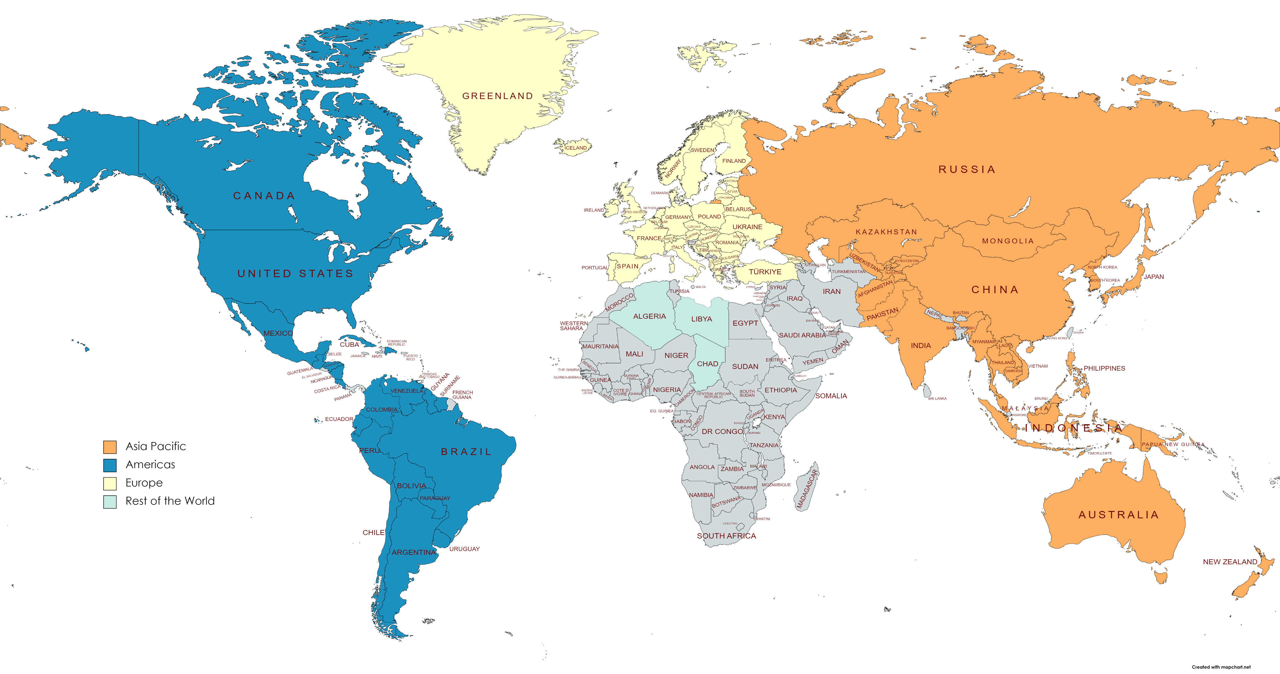
Industrial Robotics
Industrial Robotics| Regional Analysis,2021
In 2021, Asia Pacific solidified its position as the world's largest industrial robot market with 380,911 units installed, marking a 38% increase from 2020's 276,651 units.
~74% of all newly deployed robots globally found their place in Asia up from 70% in 2020. Over the span of 2016 to 2021, annual robot installations exhibited an average growth of +14%.
Europe (second-largest market) experienced a +24% increase in robot installations, totaling 84,302 units. The annual average growth rate for Europe from 2016 to 2021 was +8%.
In the Americas, installations surged by 31% in 2021, totaling 50,712 units. The United States the largest market in the Americas accounted for 68% of the 2020 installations in the region 34,987 units.
Industrial Robotics Market, Regional Share, 2021
Asia Pacific | 59.06%
Europe | 18.27%
Americas | 15.44%
Rest of World | 7.23%
Note(s): (a) Robotic patents till 2019 is sourced from public domain, from 2019 onwards data is forecasted considering market trends, historic curve and expected growth rate,
Sources: Center for Security and Emerging Technology, World Robotics 2022

Slide 13
Industrial Robotics
Industrial Robotics| Key Trends & Developments
Industrial automation relies on industrial robots for core operations in sectors like e-commerce, electronics, and automotive. IoT integration and global robotics investments drive market growth, exemplified by China's "Made in China 2025" initiative, focusing on quality and innovation in manufacturing..
Several factors drive market growth: demand for top-tier products requiring process visibility, energy conservation, workplace safety concerns, tech advancements, and expanding manufacturing infrastructure. In 2022, 44,196 robots were procured, up 11% from the previous year, as per A3 data
Industry 4.0, the newest industrial revolution, has fueled the development of new technologies, like collaborative robots, AI-enabled robots, etc., and has enabled industries to use robots to streamline many processes, increase efficiency, and eliminate errors. Increased workplace safety and improved production capabilities have further driven industries to invest in robotic systems.
As profit margins tighten, the electronics industry embraces customized production with versatile robots handling assembly and palletizing. Advanced robotics, including end effectors and vision systems, drive demand. This enables factory workers to prioritize tasks like final inspection and quality control, aided by collaborative robo
Growing usage of industrial robotics in modern automation across various sectors
Increasing popularity of Industry 4.0
Higher customization and efficiency
Note(s): (a) Robotic patents till 2019 is sourced from public domain, from 2019 onwards data is forecasted considering market trends, historic curve and expected growth rate,
Sources: Center for Security and Emerging Technology

Slide 14








Industrial Robotics
Industrial Robotics| Products/Technologies Launches
During July 2022, ABB and SKF entered into a Memorandum of Understanding (MoU) with the aim of exploring potential collaboration opportunities in the domain of manufacturing process automation. The partnership between ABB and SKF was established to jointly assess and examine potential solutions that could enhance manufacturing and processing capabilities across various industries, including food processing. This collaboration aims to assist clients in achieving higher levels of production efficiency and operational excellence.
In May 2022, Cornell University unveiled a novel industrial robot weighing 6,000 pounds. This robotic innovation holds the potential to revolutionize the construction industry by introducing large-scale 3D printing for building projects. The integration of 3D printing technology could lead to enhanced efficiency and sustainability in construction, primarily by reducing waste generated from traditional material processing methods. Among higher education institutions in the United States, Cornell stands out as one of the few using such an advanced system.
The newly introduced IRB 6650S Industrial Robot system became part of Cornell's resources in February 2022. The Bovay Lab underwent training to effectively operate this robotic system, which essentially encompasses a long and swiveling arm. Over the past several months, the lab has conducted multiple medium-sized test prints using the robot, crafting items like benches and planters. This pioneering effort at Cornell exemplifies the institution's commitment to exploring innovative applications of robotics and 3D printing in construction practices.
During February 2022, Comau and IUVO unveiled wearable robotics solutions designed to enhance the efficiency of operators involved in manual load movement tasks. The primary objective of this introduction is to prioritize operator well-being by effectively reducing lower back fatigue.
In January 2022, Yaskawa Electric Corporation acquired additional shares of Doolim-Yaskawa Co., Ltd. This strategic move was aimed at reinforcing their presence in the sealing system and robotic painting market segments.
In January 2022, KUKA and Ford Otosan from Turkey entered into a fresh framework agreement. This agreement pertains to the delivery of over 700 robots for Ford's upcoming project involving electric and connected commercial vehicles at its Cocaeri plant. Notably, this contract underscores the ongoing corporate collaboration that has persisted for more than two decades.

